Slide 1
Lecture 12: the module
random
CSC111: Introduction to CS through Programming
R. Jordan Crouser
Assistant Professor of Computer Science
Smith College

Slide 2
Announcements

Slide 3
Overview
Announcements
Debrief of “Life Skill #2: Debugging”
Loops
for…in (looping through items in a list)
the range() function (getting a list of numbers)
while (looping until something happens)
The random module
Lab: Old MacDonald
Life Skill #3: Documentation

Slide 4

Recap - Assignment #3: Magic 8 Ball

Slide 5

Discussion
What does it mean
for something to be random?

Slide 6
Expectation #1: even distribution

Slide 7
Expectation #1: even distribution
Every value has an equal chance of being chosen
Example: if we roll a die several times, we expect to see:
1 roughly 1/6 of the time
2 roughly 1/6 of the time
3 roughly 1/6 of the time, etc.
On average (over a large number of samples) the distribution is roughly uniform

Slide 8
Discussion
Is an even distribution
enough?

Slide 9
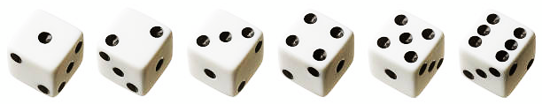
What if the die always rolled like this?

Slide 10

Expectation #2: unpredictable

Slide 11
Expectation #2: unpredictable
Randomness is more than ensuring that every value has an equal chance of being chosen
We also want each value to be hard to predict
Specifically: seeing several values in the series (“rolls”) shouldn’t help us guess the next one

Slide 12
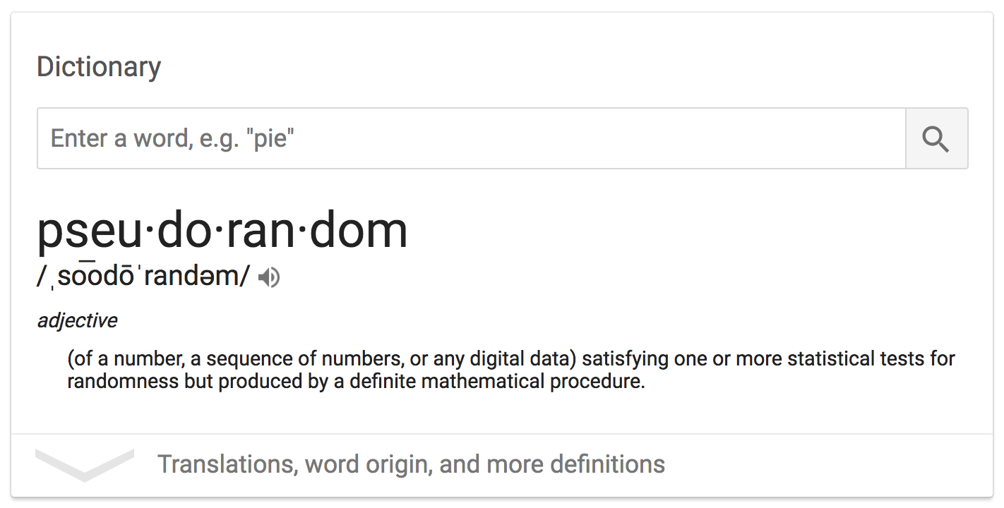
Pseudorandom numbers
“random enough"
“random number
generator” (RNG)

Slide 13
Discussion
How could a deterministic machine
generate a (seemingly) random value?

Slide 14
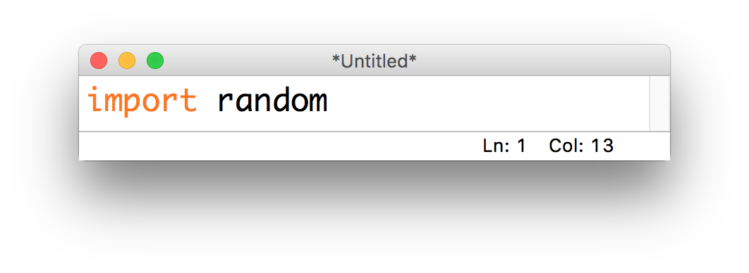
The random module
Python’s built-in RNG can be accessed through the random module
This module contains several useful functions, all of which are documented here:
https://docs.python.org/3/library/random.html

Slide 15
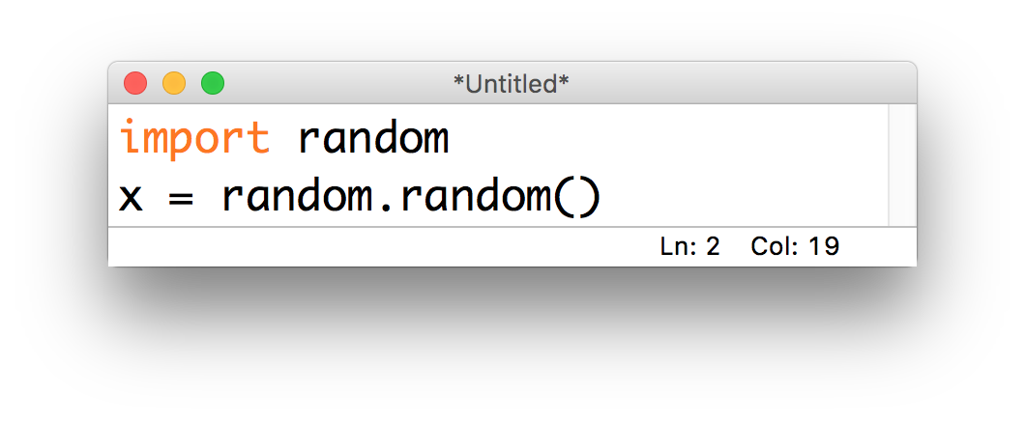
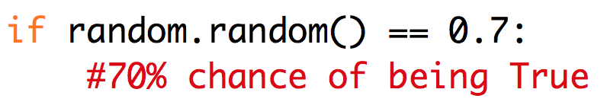
Generating a random float
The simplest way to get a random number is by calling the .random() function:
This always returns a float with a value in [0.0, 1)
Particularly useful for setting probabilities:

Slide 16
10-minute exercise: coin flip
Use the .random() function from the random module to write a program that prints HEADS 50% of the time and TAILS the remaining 50% of the time

Slide 17
Discussion
What if we wanted a random float
in a different range?

Slide 18
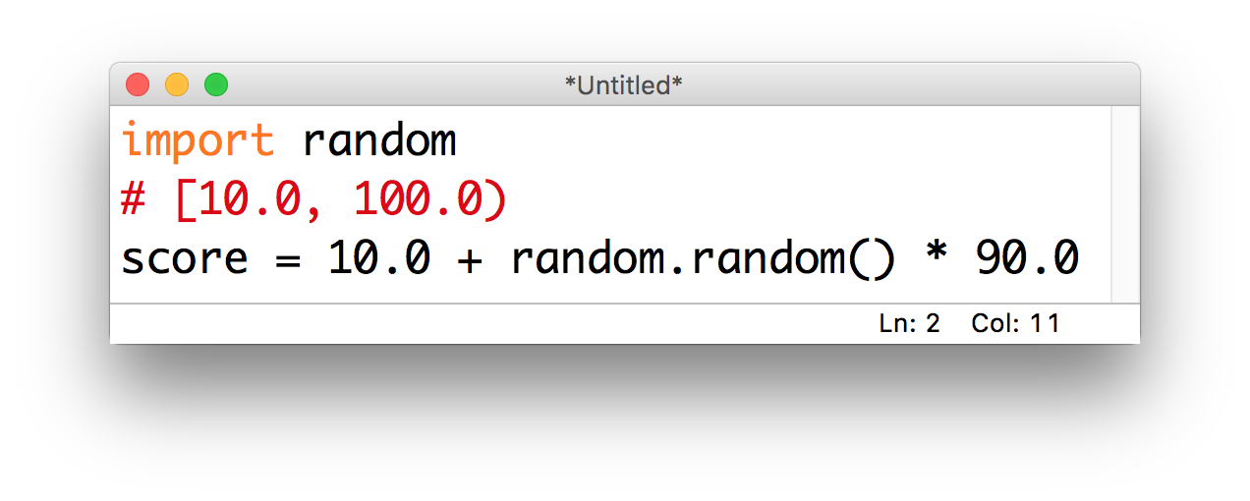
random floats in other ranges
Just use math!
Example: imagine a homework assignment is scored out of 100 points (partial points allowed, and you get 10 points for writing your name)

Slide 19
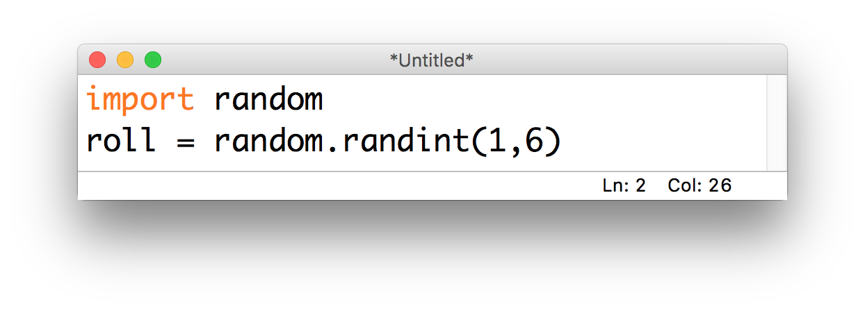
Generating a random integer
We could multiply, add and call int(...) to get a random integer using .random(), but there’s no need!
The .randint(...) function takes two arguments min and max, returns an integer in [min, max] (inclusive):

Slide 20
Discussion
How could we use this to choose a
random item from a list?

Slide 21
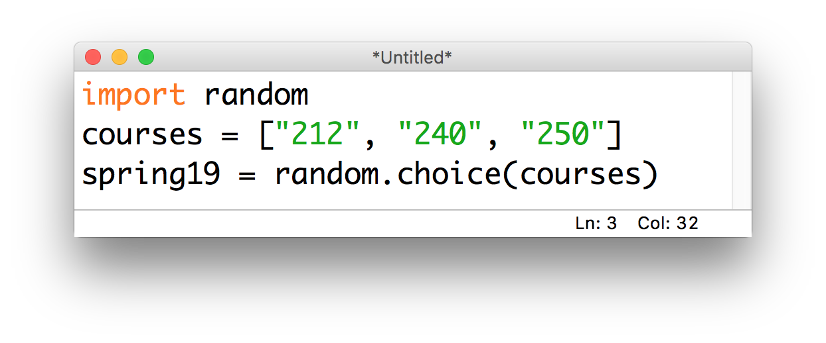
Choosing a random item
Unsurprisingly, other people have also noticed that this would be a useful feature… so there’s a function for that!
The .choice(...) function takes in a list, and returns a randomly selected element:

Slide 22
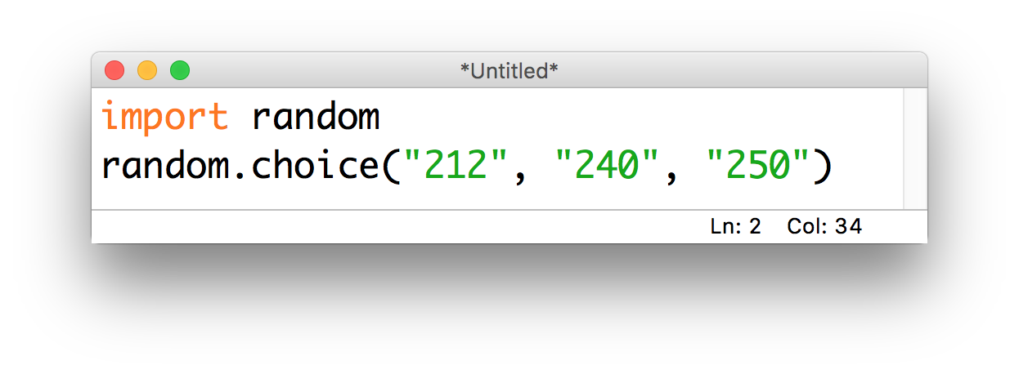
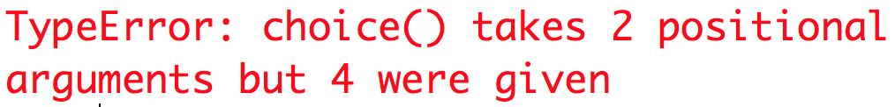
A common gotcha
The .choice(...) function only works when given a list-like object:
Don’t forget the brackets!

Slide 23
Discussion
What happens if we
call .choice(...) on a string?

Slide 24
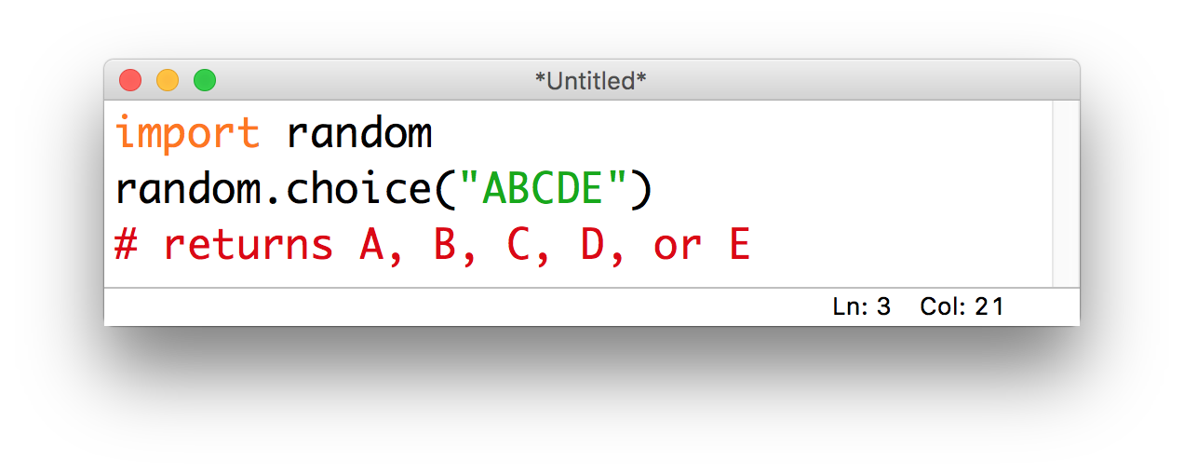
.choice(...) on strings
Strings are list-like!
The “items” in a string are the individual characters, so this is what .choice(...) chooses between:

Slide 25
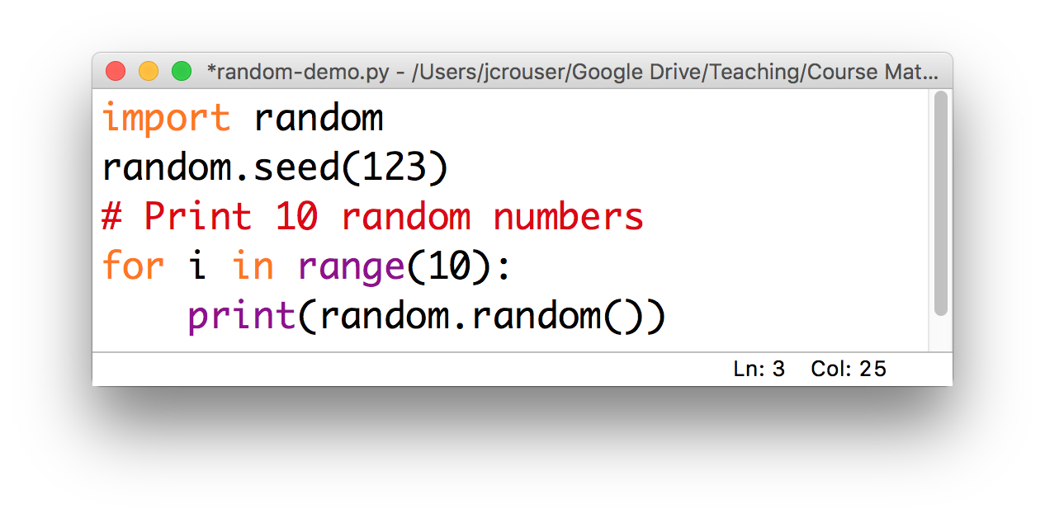
A note on testing random programs
It can be really challenging to test a program that behaves differently every time you run it
In order to solve this, we can tell python precisely how to generate its (not-so-random-anymore) random numbers using a parameter called a seed

Slide 26
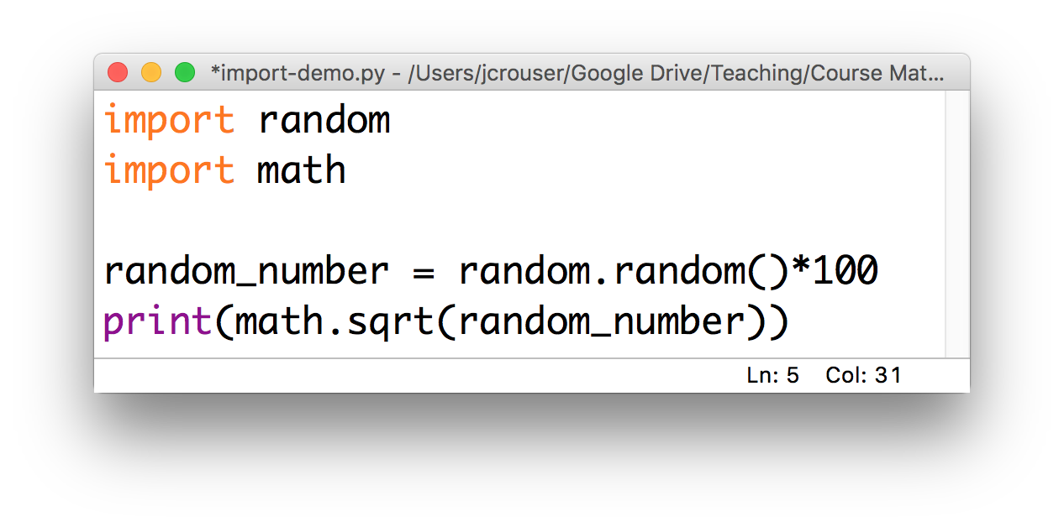
A note on importing modules
So far, we’ve always imported modules like this:

Slide 27
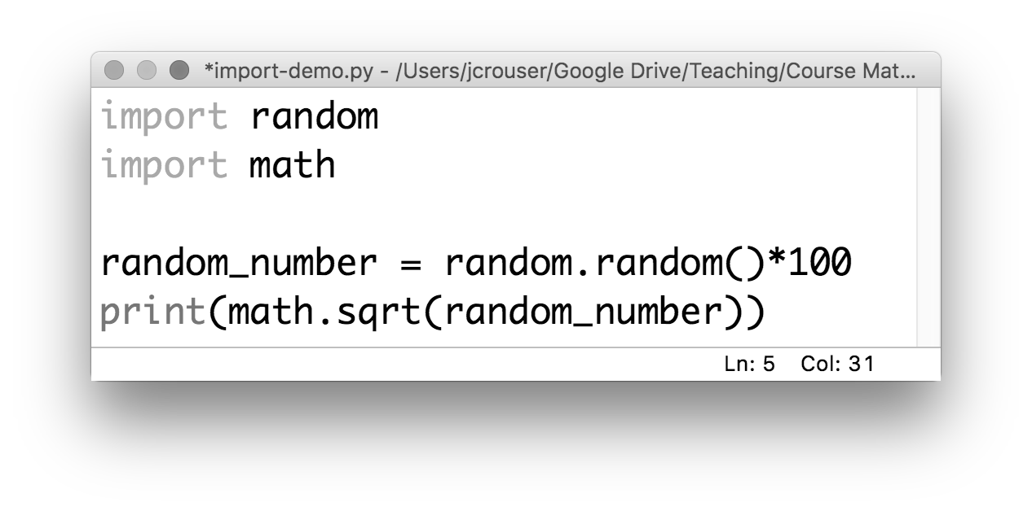
A note on importing modules
To use a function, we need to specify the module:
This prevents “name clashes” (i.e. if two functions have the same name, the second one overwrites the first)

Slide 28
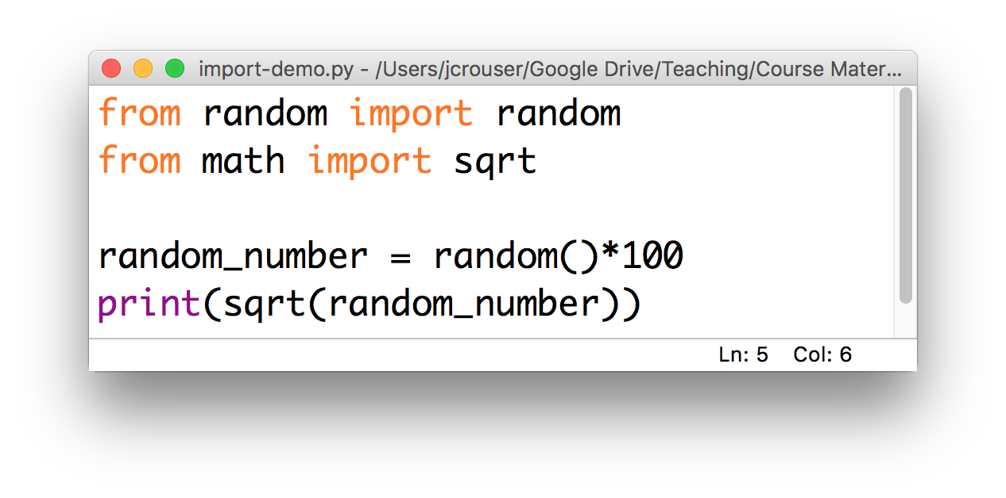
A note on importing modules
However, there’s also another way:
This is useful if we only need specific functions and we want to save ourselves some typing

Slide 29
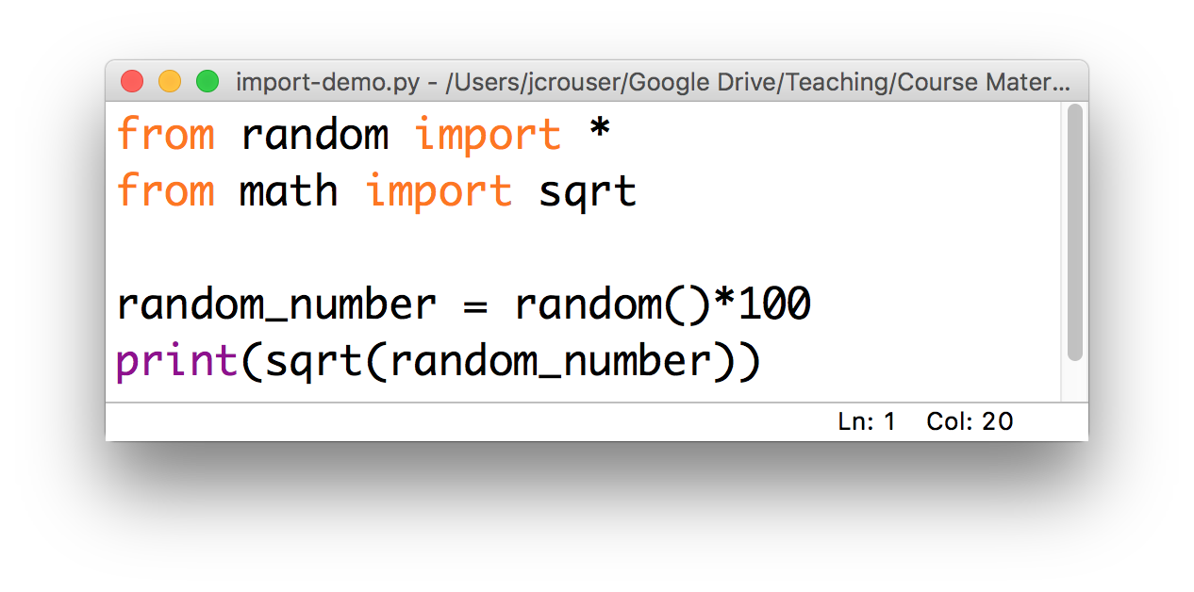
A note on importing modules
We can use * to import everything from a module :
Again, just be cautious of name clashes…

Slide 30
Overview
Announcements
Debrief of “Life Skill #2: Debugging”
Loops
for…in (looping through items in a list)
the range() function (getting a list of numbers)
while (looping until something happens)
The random module
Lab: Old MacDonald
Life Skill #3: Documentation

